Slide 1
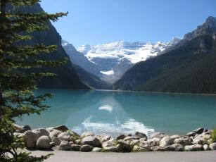
Modeling Streamflow in Glacier Dominated Basins
Presented by: Fernando R. Salas
Time Series Analysis, Modeling and Control
May 10, 2011
Notes:
Source: http://beautifulplacestovisit.com/wp-content/uploads/2009/11/Lake-Louise-Alberta-Canada.jpg

Slide 2
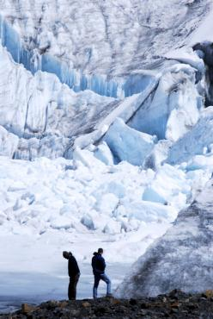
Outline
Motivation for modeling glacier fed water systems
Case Studies
Inflow to Toktogul Reservoir in the Himalayas
Inflow to Canon de Pato Dam in the Andes
Models and Results
Are system dynamics in the Himalayas
similar to the Andes?
Do monthly models translate to an annual
scale?
Where do we go from here?
Stochastic models vs. physical models
Notes:
Source: McKinney presentation

Slide 3
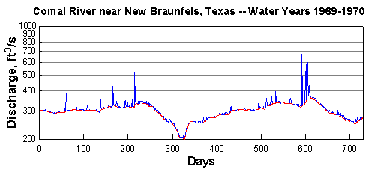
Modeling Glacier Fed Water Systems
Annual prediction and planning
Mass balance at both monthly and annual time scales
Constituents
Inputs
Precipitation, Groundwater and Glacial Melt
Outputs
Evaporation, Streamflow

Slide 4
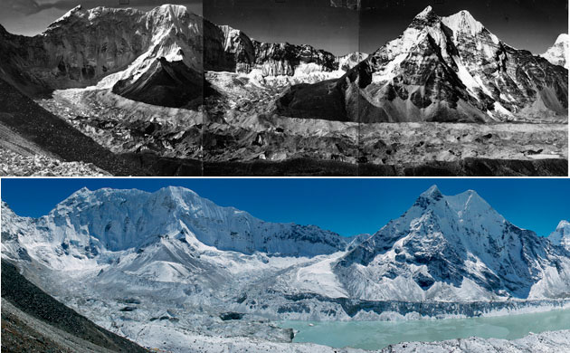
Climate Change
Notes:
Source: http://www.vriendenvantibet.be/persberichten/8nov09arunachal.html

Slide 5
Outline
Motivation for modeling glacier fed water systems
Case Studies
Inflow to Toktogul Reservoir in the Himalayas
Inflow to Canon de Pato Dam in the Andes
Models and Results
Are system dynamics in the Himalayas
similar to the Andes?
Do monthly models translate to an annual
scale?
Where do we go from here?
Stochastic models vs. physical models
Notes:
Source: McKinney presentation

Slide 6
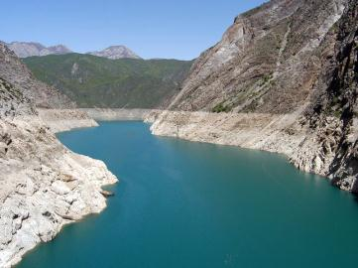
Toktogul Reservoir
Located in Kyrgyzstan on the Naryn River
Naryn River is glacially fed by the Himalayas
Average annual streamflow is 650 m³/sec
Hydroelectric station
Largest power plant in the country (1.2 GW)
Notes:
Source: http://www.rferl.org/content/article/1144627.html

Slide 7
Toktogul Monthly Streamflow (MCM)

Slide 8
Toktogul Monthly Flow Regime

Slide 9
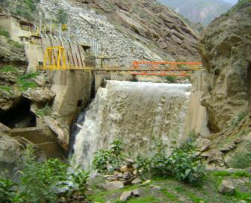
Canon del Pato Dam
Located in the Ancash region of Peru on the Santa River
Santa River is glacially fed by the Andes
One of the most susceptible areas in the world to climate change
Hydroelectric station powers capital (Lima)
Notes:
Source: http://www.rferl.org/content/article/1144627.html

Slide 10
Canon del Pato Monthly Streamflow (MCM)

Slide 11
Canon del Pato Monthly Flow Regime

Slide 12
Outline
Motivation for modeling glacier fed water systems
Case Studies
Inflow to Toktogul Reservoir in the Himalayas
Inflow to Canon de Pato Dam in the Andes
Models and Results
Are system dynamics in the Himalayas
similar to the Andes?
Do monthly models translate to an annual
scale?
Where do we go from here?
Stochastic models vs. physical models
Notes:
Source: McKinney presentation

Slide 13
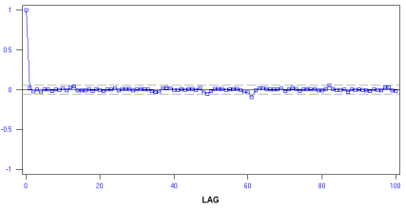
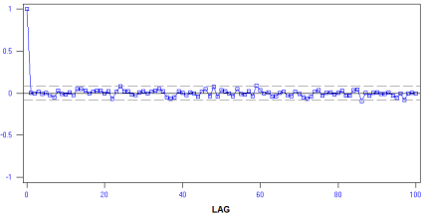
ARMA(n,m) Monthly Models
Toktogul – ARMA(14,13)
Canon del Pato – ARMA(16,15)

Slide 14
Monthly Model Trends
Toktogul – ARMA(14,13)
Canon del Pato – ARMA(16,15)
Seasonality
12, 6, 4, and 3 month
Green’s Function peak at lag 12
Seasonality
12, 6, 4, 3 and 2 month
Green’s Function peak at lag 12

Slide 15
Green’s Function

Slide 16
What About Annual Time Scales?

Slide 17
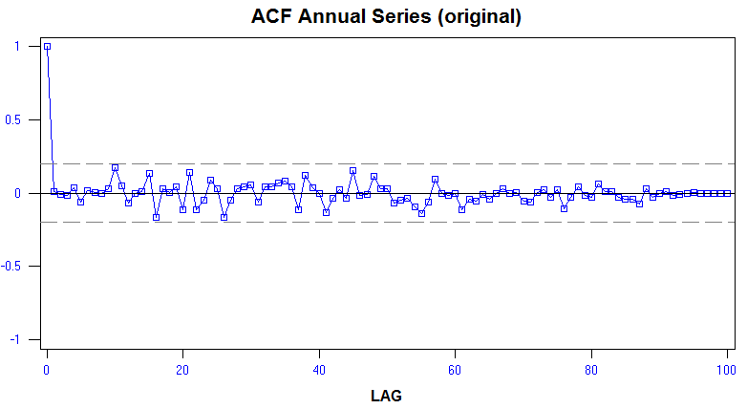
Toktogul Annual Model
ARMA(3,2)
No significant trends
No seasonality

Slide 18
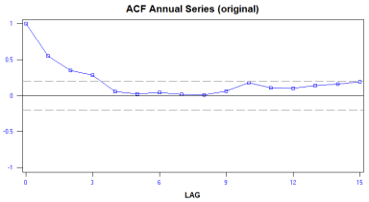
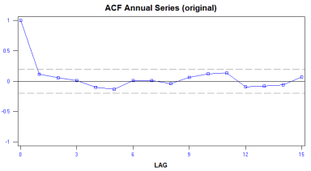
Toktogul Seasonal Model?
January Streamflow (MCM)
June Streamflow (MCM)

Slide 19
Model Comparison – One Year Prediction

Slide 20
Best Model for Predicting Annual Flow
Model | Coefficient of Determination | Predictive Variance
Monthly Model | 0.079 | 1,597,370
Annual Model | 0.063 | 5,471,120
Seasonal Model | 0.089 | 1,474,168

Slide 21
Outline
Motivation for modeling glacier fed water systems
Case Studies
Inflow to Toktogul Reservoir in the Himalayas
Inflow to Canon de Pato Dam in the Andes
Models and Results
Are system dynamics in the Himalayas
similar to the Andes?
Do monthly models translate to an annual
scale?
Where do we go from here?
Stochastic models vs. physical models
Notes:
Source: McKinney presentation

Slide 22
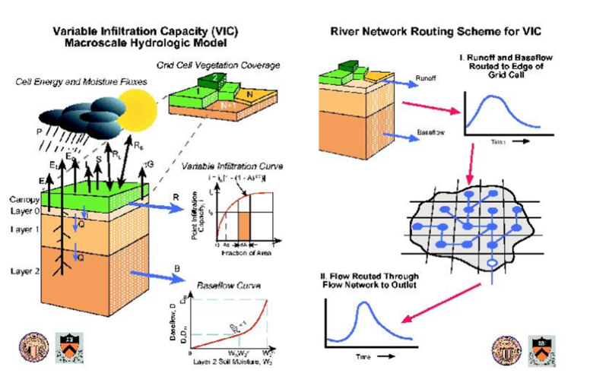
Hydrologic Models/Physical Models
Notes:
Source: http://www.awra.org/proceedings/www99/w61/vicpic.jpg

Slide 23

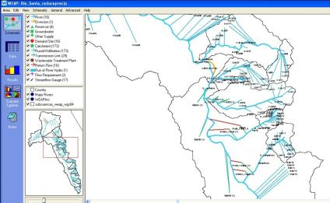
Water Evaluation and Planning (WEAP) Model
Climate Inputs
Temperature, precipitation, humidity, wind speed
Soil Moisture Model
Glacier model
Irrigation
Scenario Exploration

Slide 24
Canon del Pato Monthly Streamflow

Slide 25
Stochastic Models vs. Physical Models
 | Coefficient of Determination
Monthly ARMA Model | 0.64
Monthly WEAP Model | 0.71

Slide 26
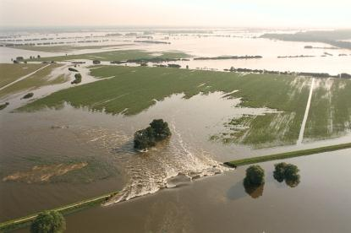
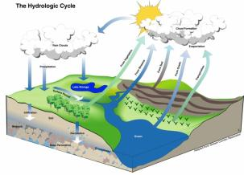
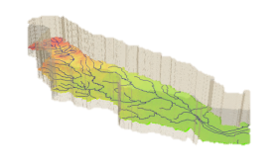
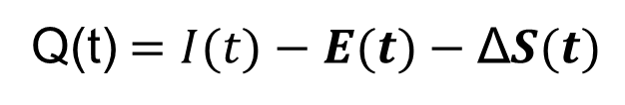
Hydrologic Cycle
I(t) Precipitation
E(t) Evaporation
Q(t) Streamflow
Q(t)$=I(t)−E(t)−\text{Δ}S(t)$

Slide 27
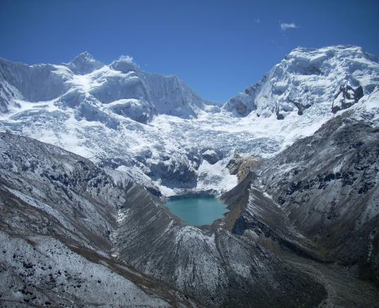
Questions?

